Slide 1
PlagiaBust - Plagiarism Detection Framework
Supervised by : Dr. Malaka Walpola
Mr. Chulaka Gunasekara

Slide 2
Flow of the Presentation
Plagiarism
What is PlagiaBust
Features
Overview to PlagiaBust system
R&D
Q & A

Slide 3
Plagiarism
Plagiarism is the unauthorized use of others work without acknowledgment.
Availability of Internet materials has made it easy for students to plagiarize from Internet resources.
Huge threat to intellectual property of original authors.

Slide 4
What is PlagiaBust?
A free and open source Plagiarism detection software.
Based on text mining techniques.
Developed using Java based technologies and tools.

Slide 5
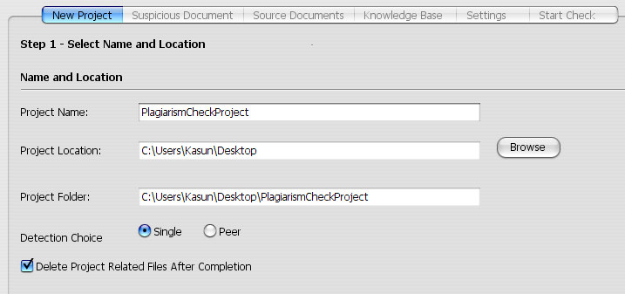
Features
Plagiarism detection in single and within multiple documents

Slide 6
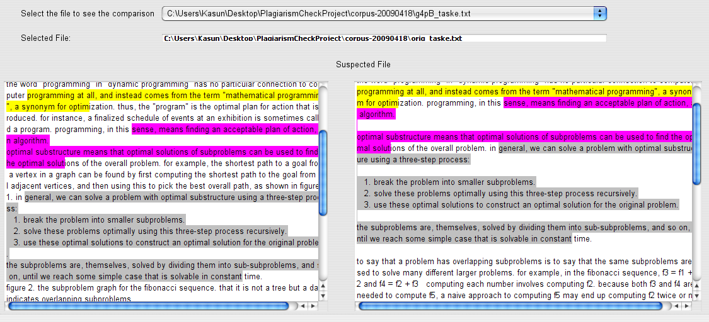
Features
Copy paste Plagiarism detection

Slide 7
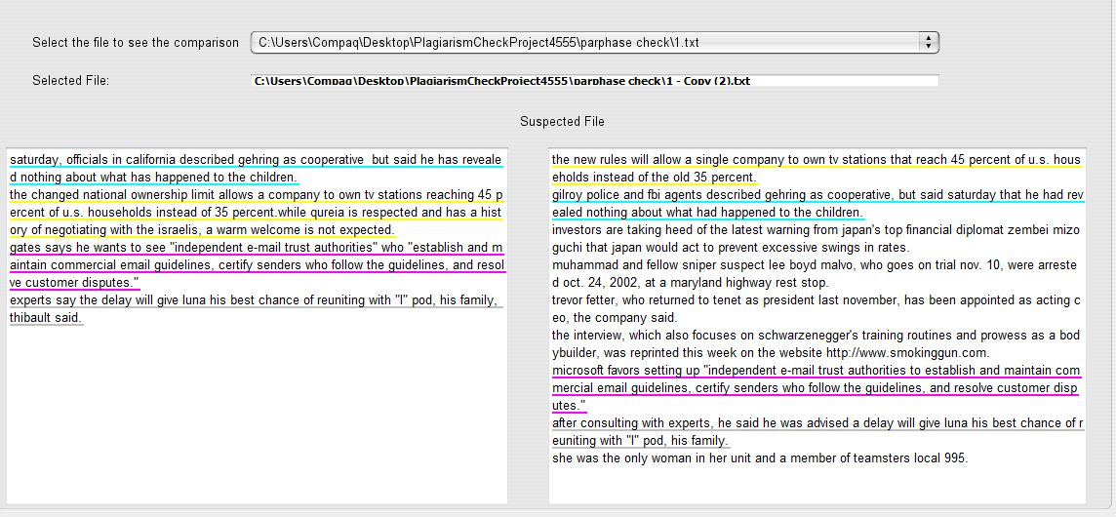
Features
Paraphrase Plagiarism detection

Slide 8
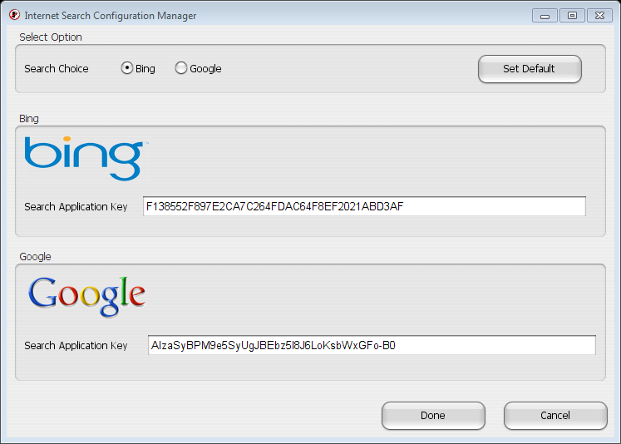
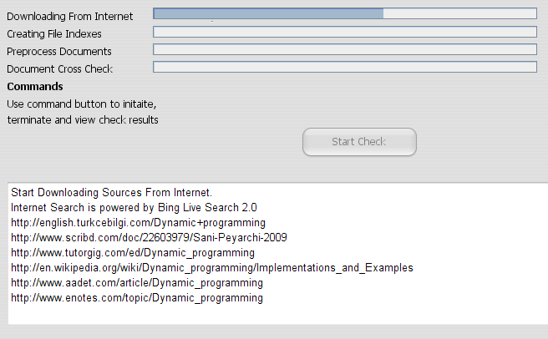
Features
Detection of Internet Plagiarism

Slide 9
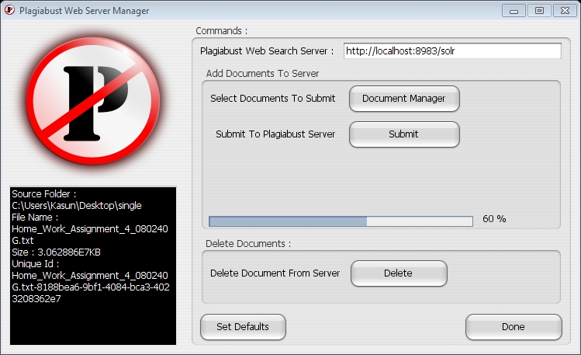
Features – Alternative
Detection of PlagiaBust server sources.

Slide 10
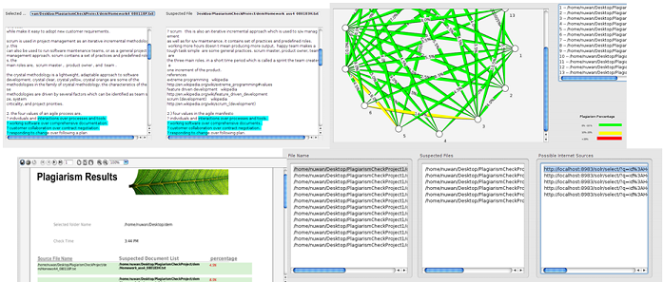
Features (Cont..)
Rich user experience.

Slide 11
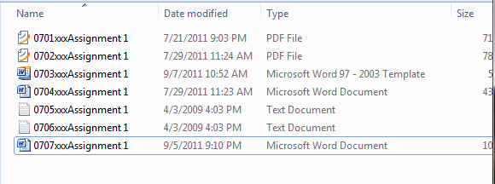
Features (Cont..)
Supports for most commonly used document types.

Slide 12
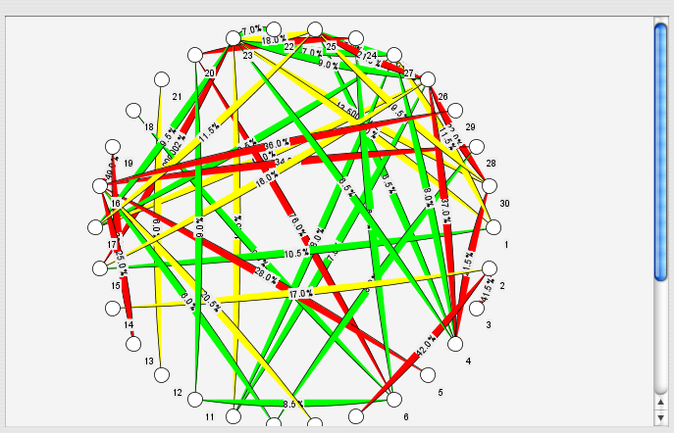
Features (Cont..)
Graphical representation of Plagiarism detection results using
Connectivity Graphs

Slide 13
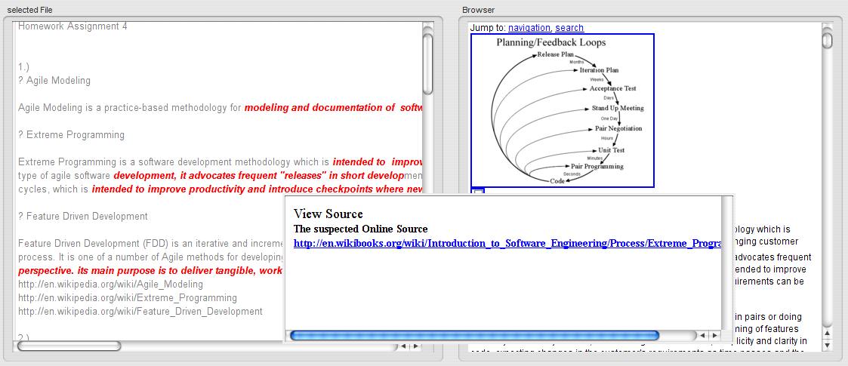
Features (Cont..)
Internet source browser

Slide 14
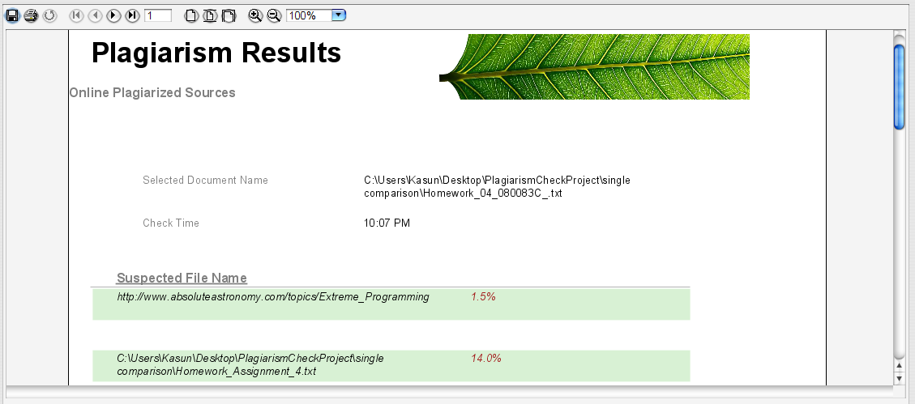
Features (Cont..)
Comprehensive and exportable final report

Slide 15
Overview of the PlagiaBust System
Data Extraction Module
PlagiaBust Server Sources Detection Module
Data Preprocessing Module
External Source Detection Module
Matching Engine
Internet Source Detection Module
Reporting Generator Module
Storage Interface
Storage

Slide 16
Research And Development
Data Extraction Module
PlagiaBust Server Sources Detection Module
Data Preprocessing Module
External Source Detection Module
Matching Engine
Internet Source Detection Module
Reporting Generator Module
Storage Interface
Storage

Slide 17
Data Extraction Module R&D
Document Type Support
Convert all document formats into text format
(pdf, doc, docx, rtf, txt)
PDF - Apache PDF Box version 0.7.3
MS Word formats - docx, doc - Apache POI 3.7
rtf – RTFEditorKIT java 1.6.0

Slide 18
Research And Development
Data Extraction Module
PlagiaBust Server Sources Detection Module
Data Preprocessing Module
External Source Detection Module
Matching Engine
Internet Source Detection Module
Reporting Generator Module
Storage Interface
Storage

Slide 19
External Source Detection R&D
Query Selection Algorithms – Using Plagiabust Testing Framework
Exhaustive selection
Flesch-Kincaid Grade Level
Random selection
Paragraph wise query selection
Internet Search
Querying using Bing search
Querying using Google search
PlagiaBust Web Search Service
Apache Solr

Slide 20
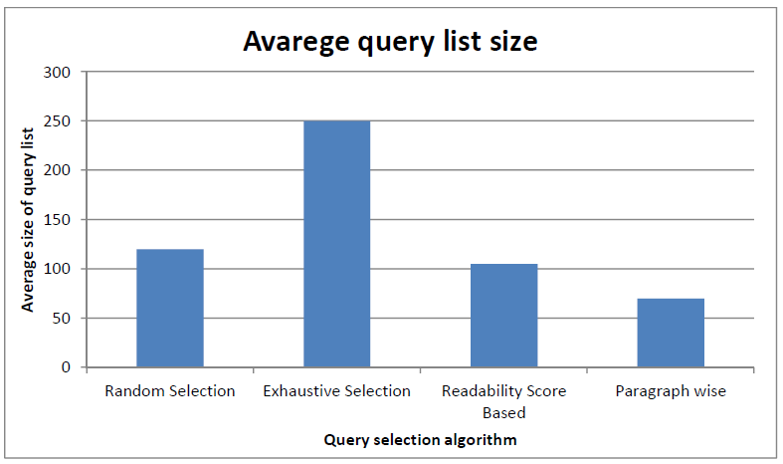
External Source Detection R&D
Query Selection Algorithm
Paragraph wise query selection
Testing Corpus - set of 100 documents, each contain approximately 3000 words

Slide 21
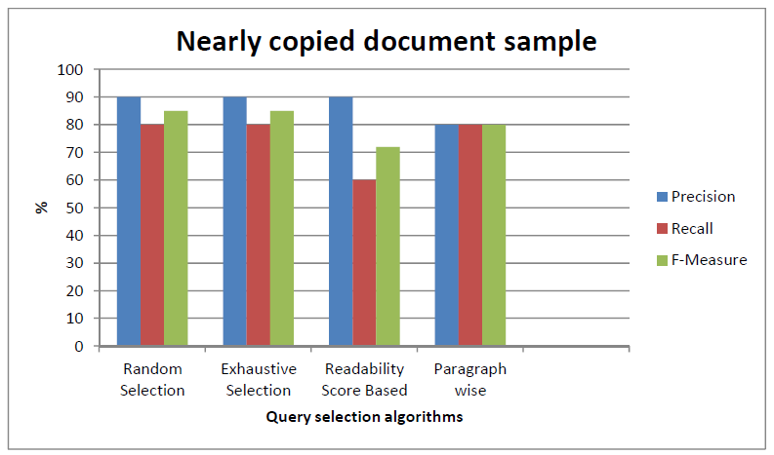
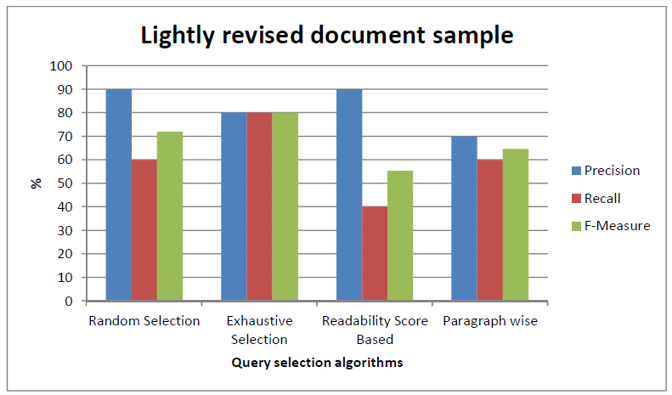
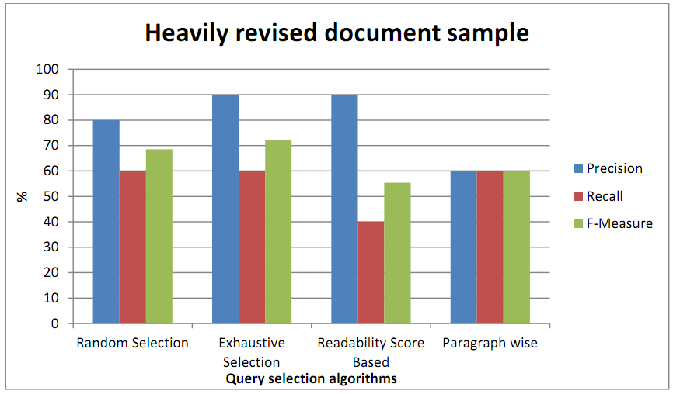
External Source Detection R&D

Slide 22
Research And Development
Data Extraction Module
PlagiaBust Server Sources Detection Module
Data Preprocessing Module
External Source Detection Module
Matching Engine
Internet Source Detection Module
Reporting Generator Module
Storage Interface
Storage

Slide 23
Data Pre-processing R&D
Stemming Algorithms – convert words root form
Martin Porters Algorithm
Lovins Algorithm
Stop Words Removal – remove common words (a, the,..)
Apache Lucene StopAnalyzer
Apache Lucene SnowballAnalyzer
Synonym Replacement
WordNet - lexical database for the English language
JWNL (Java WordNet Library)
JWI (MIT Java Interface to Wordnet)
Lucene – WordNet (Apache lucene team)

Slide 24
Data Pre-processing R&D
Synonym Replacement
JWNL (Java WordNet Library) vs Lucene – WordNet (Apachelucene)

Slide 25
Overview of the PlagiaBust System
Data Extraction Module
PlagiaBust Server Sources Detection Module
Data Preprocessing Module
External Source Detection Module
Matching Engine
Internet Source Detection Module
Reporting Generator Module
Storage Interface
Storage

Slide 26
Matching Engine R&D
Paraphrase Detection
Text Semantic Similarity Calculation
get semantic relationship
Surface Text Similarity
recognition methods operate directly on the input surface strings
Based on Syntactic Similarity
work at the syntax level (grammar)
Employ Machine Learning – train on data set

Slide 27
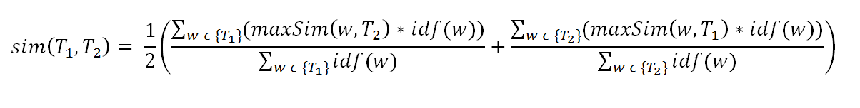

Matching Engine R&D
Paraphrase Detection
Equation– Semantic Similarity calculation
Testing Corpus - Microsoft Research Paraphrase Corpus
contains 5801 pairs of sentences obtained from online news articles referring to same event
approximately 67% of the 5,801 pairs were judged to be paraphrases.

Slide 28
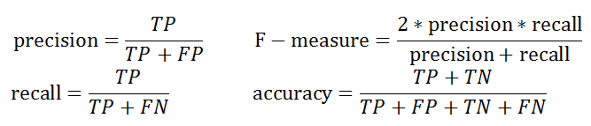
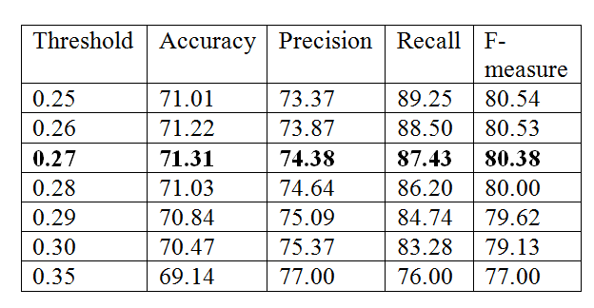
Matching Engine R&D
Paraphrase Detection
Accuracy Measures
Threshold value selection

Slide 29
Matching Engine R&D
Comparison with available methods
Method | Accuracy (%) | Precision (%) | Recall (%) | F-measure (%)
Corley &Mihalcea (2005) | 71.5 | 72.3 | 92.5 | 81.2
Das & Smith (2009) | 76.1 | 79.6 | 86.1 | 82.9
Finch (2005) | 75.0 | 76.6 | 89.8 | 82.7
Malakasiotis (2009) | 76.2 | 79.4 | 86.8 | 82.9
Qiu (2006) | 72.0 | 72.5 | 93.4 | 81.6
Wan (2006) | 75.6 | 77.0 | 90.0 | 83.0
Zhang & Patrick (2005) | 71.9 | 74.3 | 88.2 | 80.7
Our Method | 71.31 | 74.38 | 87.43 | 80.38
BASE1 | 66.5 | 66.5 | 100.0 | 79.9
BASE2 | 69.0 | 72.4 | 86.3 | 78.8

Slide 30
Matching Engine R&D
Copy - Paste Detection
Textual Comparison Algorithms
Cosine Similarity
Euclidean Distance
Greedy String Tiling
ShingleCloud

Slide 31
Matching Engine R&D
Textual Similarity Algorithm Comparison
Similarity measures given by algorithms for about 60% copied set of documents

Slide 32
Matching Engine R&D
ShingleCloud Algorithm
N-Gram overlap text comparison
Needle and Haystack strings
Extract shingles from needle and haystack using sliding window approach
Generating a bit string according to shingle existence in needle and haystack
Extract matching shingles from the bit string

Slide 33
Matching Engine R&D
Selecting N-Gram Size

Slide 34
Matching Engine R&D
Selecting Minimal Number of Consecutive ones

Slide 35
Research And Development
Data Extraction Module
PlagiaBust Server Sources Detection Module
Data Preprocessing Module
External Source Detection Module
Matching Engine
Internet Source Detection Module
Reporting Generator Module
Storage Interface
Storage

Slide 36
Reporting Module R&D
Available Java reporting libraries
Jasper Reports
Supports many types of data sources.
Exporting capability to .Pdf, .doc, .HTML and many more
Supports Sub Reports.
JFreeReport.
Eclipse Birt.
Available Java Graph plotting libraries
JUNG(Java Universal Network/Graph)
Supports Graph Layouts.
JGraph

Slide 37
Reporting Module R&D
Core components and features of Java Swing Framework
Main APIs Used
Java Highlighter
Java Style Document
Java Regular Expression Pattern Matching
Java Collections and Generics

Slide 38
Test Document Corpuses
PAN plagiarism detection corpus
Student assignments of University of Moratuwa Department of Computer Science & Engineering
A Corpus of Plagiarized Short Answers Created by Paul Clough (Information Studies) and Mark Stevenson (Computer Science), University of Sheffield.

Slide 39
Future Improvements
Detecting Plagiarism in coding assignments
Detecting Plagiarism in documents written in languages other than English.
Supports for more document types. Hard copied documents, pptx.

Slide 40
Q & A

Slide 41
Thank You

